Slide 1


GRADE 8 ICT/DESIGN
Lesson 5: Variables (Code.org 3b)
Ms. Abboud • Grade 8 - ICT/Design • Term 1, Week 11

Slide 2
Learning Objectives
WALT - We Are Learning To
WILF - What I'm Looking For
Create variables and use them to label values in code.
I can create a variable and give it a value.
My variable controls part of my drawing.

Slide 3
Academic Vocabulary
Variable
Assign
A label for a piece of information used in a program.
To give a variable a value, using the = sign.

Slide 4
Frayer Model: Variable
DEFINITION
CHARACTERISTICS
A label for a piece of information used in a program, so the value can be stored and reused.
Has a name; holds a value; the value can change; created with var and given a value with =.
VARIABLE
EXAMPLES
NON-EXAMPLES
var size = 100; then ellipse(200, 200, size, size);
A number typed straight into the code with no label, like the 100 in ellipse(200, 200, 100, 100);

Slide 5
National Identity Integration
UAE Smart Government: digital services keep each resident's details under a clear label so they can be reused. Variables do the same job in code.

Slide 6
STARTER
Where Does a Computer Keep Information?
Input, output, storage, processing.
Where does a computer keep information it needs later?
Hook • Engage & Ask
5 - 10 minutes

Slide 7
LESSON CORE
I Do: Meet Variables
A variable is a label for a value. Watch the Introduction to Variables video.
var creates the variable and = gives it a value. Use its name wherever you need the value.
Gradual Release of Responsibility
35 - 45 minutes
Example: one variable used as a parameter
var size = 100;
ellipse(200, 200, size, size);
1 / 3

Slide 8
LESSON CORE
We Do: Predict, Then Modify
Predict what each short program draws, then run it.
Change the value of size. What changes in the drawing?
Gradual Release of Responsibility
35 - 45 minutes
2 / 3

Slide 9
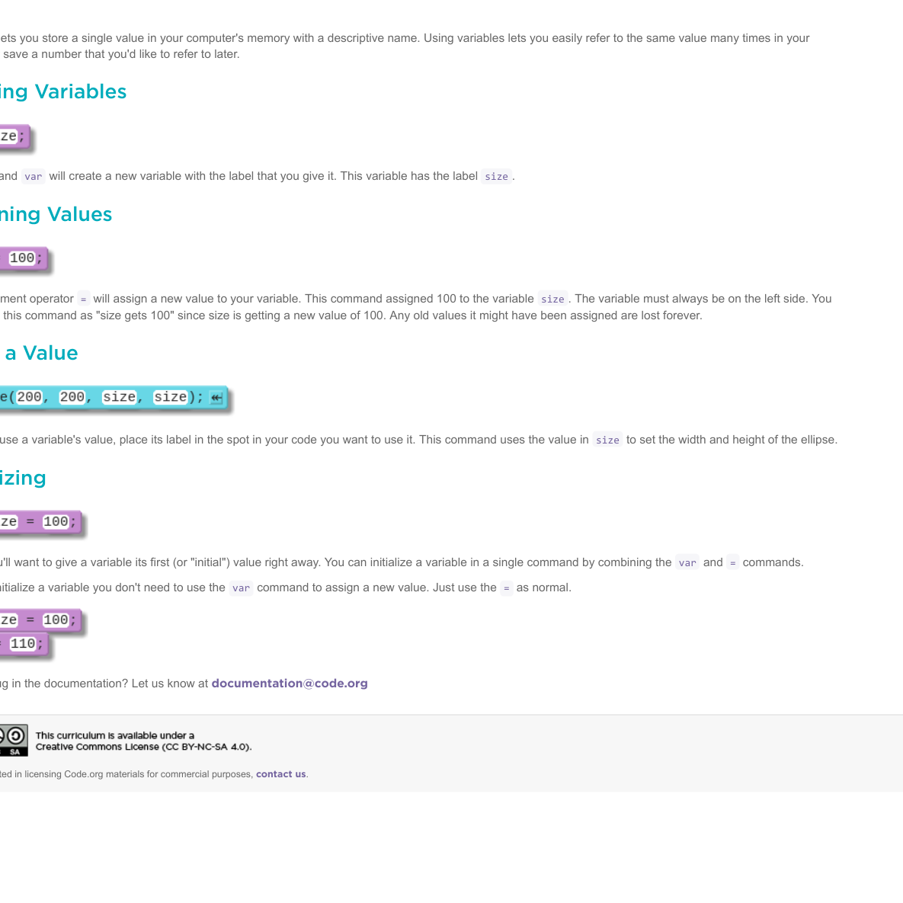
LESSON CORE
You Do: Code with Variables
Complete the Game Lab levels.
Use at least one variable to control the position, size or color of a shape.
Code.org reference: Variables
Gradual Release of Responsibility
35 - 45 minutes
3 / 3

Slide 10
CLOSURE
Exit Ticket
Define variable and explain one variable you used in your code.
Why is a good variable name important?
Transition & Extend
5 - 10 minutes

